Slide 1

Dual-Trader: One App. All Your Brokerage Accounts. Trade Smarter.
Dual-Trader simplifies multi-account trading for retail and professional traders.

Slide 2




Executive Summary
Unified Platform
Secure Integrations
Multi-broker, multi-account trading platform for real-time management and execution.
Built on secure broker APIs, ensuring safe and efficient operations.
Prototype Ready
Seeking Seed Funding
Supports simultaneous trading, account aggregation, and order placement.
To scale infrastructure, onboard users, and secure partnerships and regulatory compliance.

Slide 3

The Disconnected Trading Ecosystem
Fragmented Portfolios
Traders use multiple brokers, but existing apps lack a unified view.
Operational Headaches
Frequent logins, trade delays, and inconsistent data across platforms lead to missed opportunities.
Raj's Dilemma
An options trader using Zerodha, Upstox, and IBKR, Raj struggles with three UIs and cannot batch trades efficiently.

Slide 4




The Dual-Trader Solution
Multi-Broker Integration
Unified Dashboard
Connect and manage all your brokerage accounts seamlessly.
Consolidated view of holdings, P&L, watchlists, and orders.
Simultaneous Execution
Secure & Fast
One-click order placement across all connected brokers.
Utilizes OAuth2 and broker-compliant APIs for robust security.

Slide 5
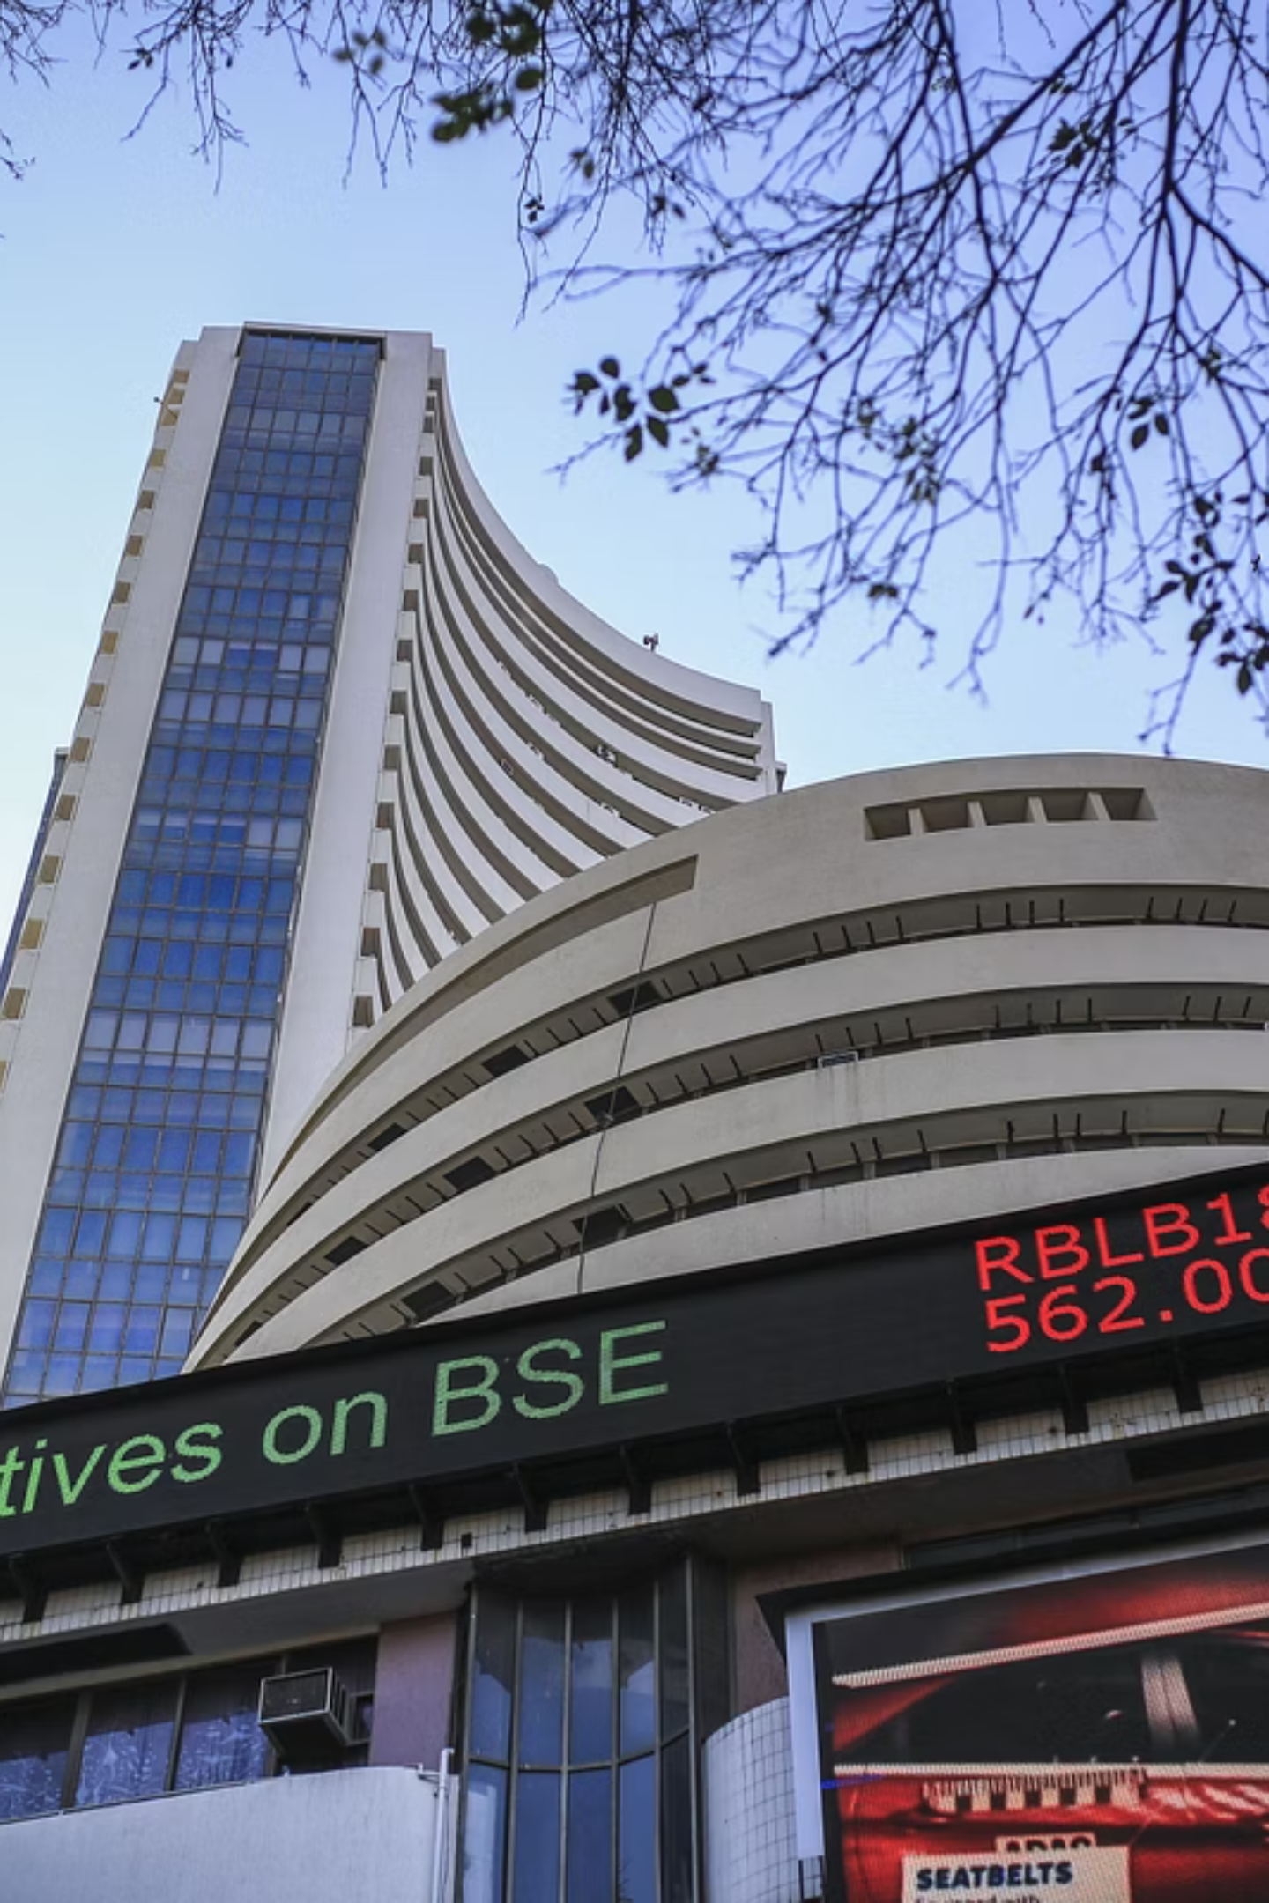
Why Now?
Market Maturation
Multi-broker trading has become mainstream, with 65% of active traders using 2+ platforms.
API Accessibility
Major brokers now offer robust APIs, enabling seamless third-party integrations.
Rising Complexity
Modern trading strategies require speed and coordination across multiple accounts and instruments.
Technology Ready
Cloud infrastructure and security protocols have matured to support enterprise-grade trading solutions.

Slide 6






Product Demo / Features
Dual-Trader's comprehensive feature set transforms how traders manage multi-broker portfolios, offering unprecedented control and efficiency in a single, intuitive platform.
Account Linking
Consolidated P&L & Positions
Seamlessly connect multiple brokerage accounts including Zerodha, Upstox, and IBKR through secure OAuth2 authentication. One-time setup enables instant access to all your trading accounts.
Real-time aggregated view of your complete portfolio performance across all brokers. Track profits, losses, and positions with detailed breakdowns by broker, instrument, and time period.
Watchlists & Price Alerts
Bulk Order Execution
Create unified watchlists combining instruments from different brokers. Set intelligent price alerts with customizable triggers for better market timing and opportunity capture.
Execute identical orders simultaneously across multiple brokers with a single click. Supports market, limit, and stop orders with intelligent routing and order management.
Trade History & Logs
Encryption & Secure OAuth
Comprehensive audit trail of all trading activities across brokers. Advanced filtering, search, and export capabilities for detailed performance analysis and compliance tracking.
Bank-grade security with end-to-end encryption, secure token management, and compliance with broker security standards. Your credentials never leave your device.

Slide 7
Business Model: Monetization Streams
₹199
30%
₹50K
Monthly Pro Subscription
Revenue Share
B2B License Fee
Unlimited broker connections, advanced analytics, and bulk order execution
Affiliate commissions from integrated brokers on user Subscription
White-labeled solutions for prop firms and portfolio management companies
Freemium Strategy
Partnership Revenue
Enterprise Solutions
Free Tier: 3 broker connections, basic dashboard
Data Monetization: Anonymized trading insights for market research
Custom Integration: Tailored solutions for trading firms
Pro Tier: Unlimited brokers, advanced features, priority support
API Access: Premium developer tools and white-label licensing

Slide 8
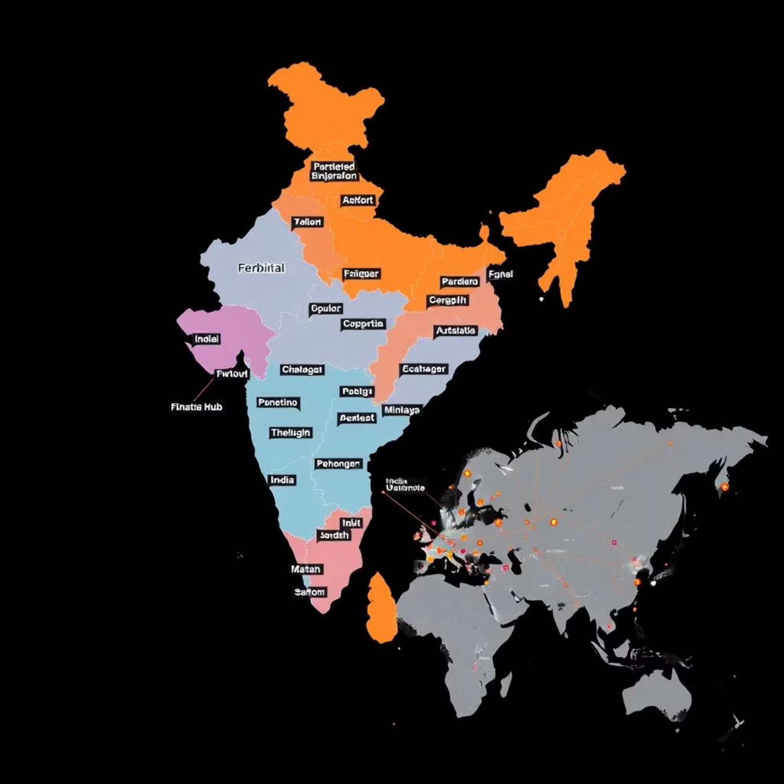
Market Opportunity
The global online trading platforms market is experiencing rapid growth, driven by increased retail investor participation and technological advancements. This presents a significant opportunity for innovative solutions like Dual-Trader.
3Cr+
15L+
Indian Retail Investors
Active Multi-Account Traders in India
15M+
Global Traders (U.S. Alone)
TAM/SAM/SOM
TAM: $10B+ Global Online Trading Platforms (addressable market)
SAM: $500M India Trading Utilities Market (serviceable market)
SOM (3% penetration): $15M (obtainable market share in India)

Slide 9
Competitive Landscape: Dual-Trader's Edge
Feature / Product
Zerodha Kite
Upstox
TradingView
Dual-Trader
Multi-broker support
❌
❌
❌
✅
Trade execution
✅
✅
❌
✅
Unified dashboard
❌
❌
❌
✅
Custom bulk order
❌
❌
❌
✅
Portfolio aggregation
❌
❌
❌
✅
Broker agnostic
❌
❌
❌
✅

Slide 10




Traction & Validation
Prototype Completed
Broker Integration
1
Functional prototype with core features.
Zerodha + Upstox OAuth & Trade Execution working.
2
Community Engagement
4
Early Adopters
Strong traction on GitHub, Reddit, and Discord trader communities.
3
10 active users testing the beta version.

Slide 11










Go-To-Market Strategy
B2B Partnerships
Community Launch
Pilot programs with small prop firms.
Target Reddit, Discord, and Twitter trading communities.
Content Marketing
SEO-driven blogs and tutorial content.
Referral & Features
Incentivized referrals and premium-only features.
Influencer Collaboration
Partner with finance/trading YouTube influencers.

Slide 12
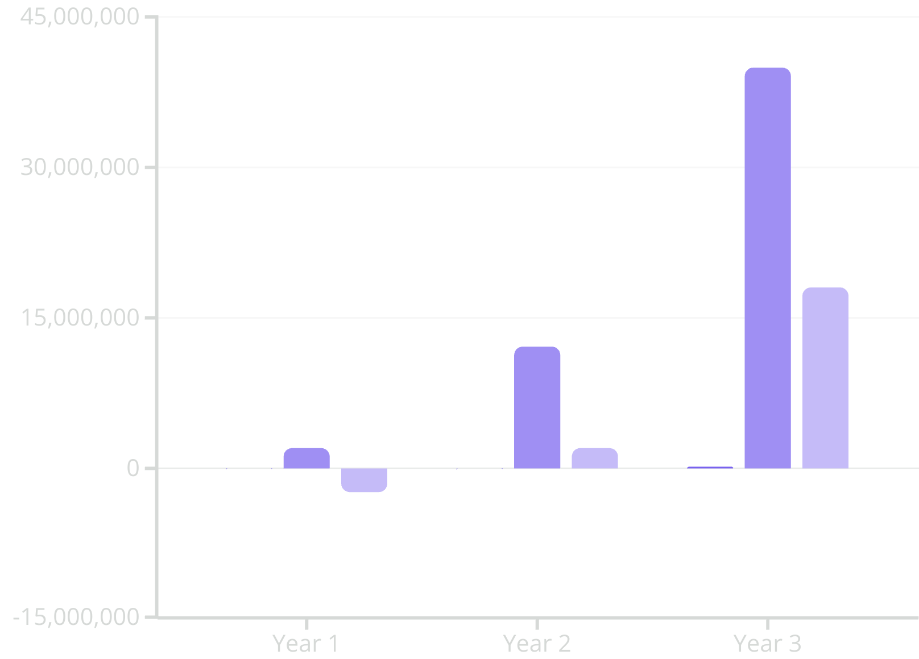
Financial Projections & Ask
Ask: ₹2 Crore (~$250K) Seed Funding
Use of Funds
50% Product Development
20% Broker Partnerships
20% Marketing & Community
10% Regulatory Compliance
Users
Revenue (INR)
EBITDA

Slide 13

Our Dynamic Team
Harsh Gupta
Next Hires
Founder & Full Stack Developer
Compliance Officer - Regulatory expertise
5+ years building scalable fintech solutions with React.js, Node.js, and Firebase. Successfully scaled multiple projects to 10k+ users and served as Ex-Solana U Ambassador.
UI/UX Designer - Intuitive trading interfaces
Backend Engineer - High-frequency trading infrastructure
Contact: hgupta42774@gmail.com | +91-8595332917
Frontend Engineer - Cross-platform development
Live Demo: github.com/harshgupta20/dual-trader

Slide 14



14. Vision & Exit Strategy
Become the Plaid for Indian Brokers
Enable Third-Party Developer Ecosystem
Strategic Exit Opportunities
Establish Dual-Trader as the de facto standard for multi-broker integration across India's financial ecosystem.
Position for acquisition by major players or scale as a revenue-generating market leader.
Open APIs to create a thriving marketplace of trading tools and applications built on our platform.
Exit Pathways
Strategic Acquisition
Financial Partnership
Lifestyle Business
Target buyers: Zerodha, Upstox, AngelOne, or international players like Robinhood entering Indian markets.
Joint ventures with exchanges (NSE/BSE) or large trading firms seeking technology infrastructure.
Scale to ₹50+ Crore ARR with 30%+ margins, providing founders with significant ongoing returns.
Estimated valuation: ₹100-500 Crore
Revenue sharing models with guaranteed minimums
Long-term wealth creation through dividends

Slide 15
Thank You
We're building the future of unified trading.
Join us.

